Slide 1
From: https://builtin.com/data-science/step-step-explanation-principal-component-analysis

Slide 2
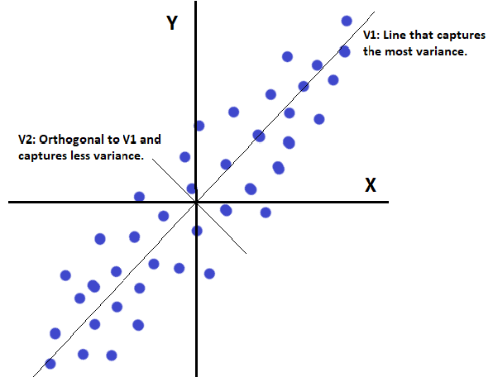

Slide 3
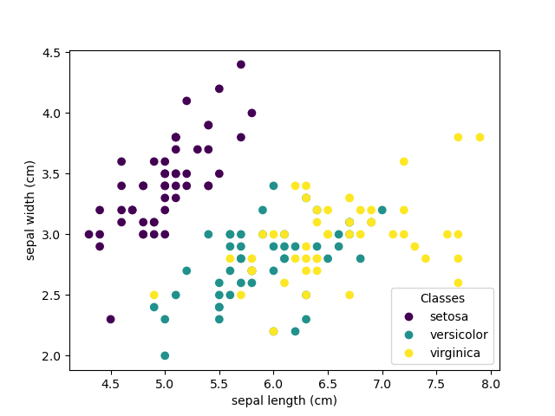
Iris Dataset
Features:
SepalLengthCm
SepalWidthCm
PetalLengthCm
PetalWidthCm
Target:
Species of Iris

Slide 4
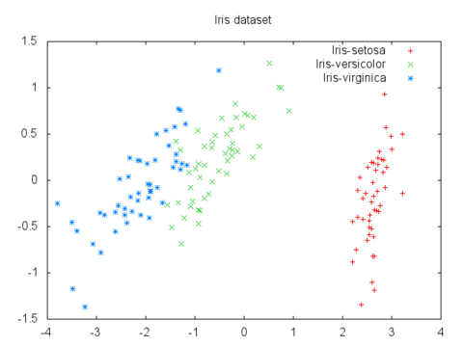
Iris Dataset
Iris Dataset Plotted with PCA

Slide 5
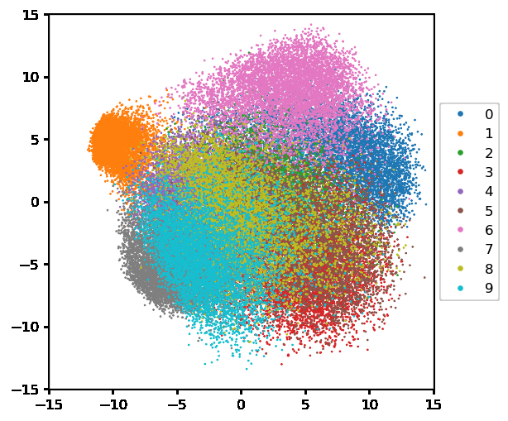
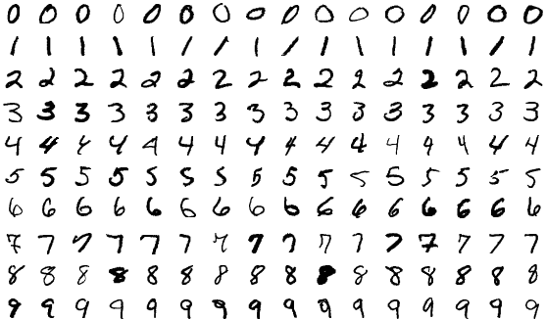
MNIST Dataset
Second principal component
First Principal Component

Slide 6
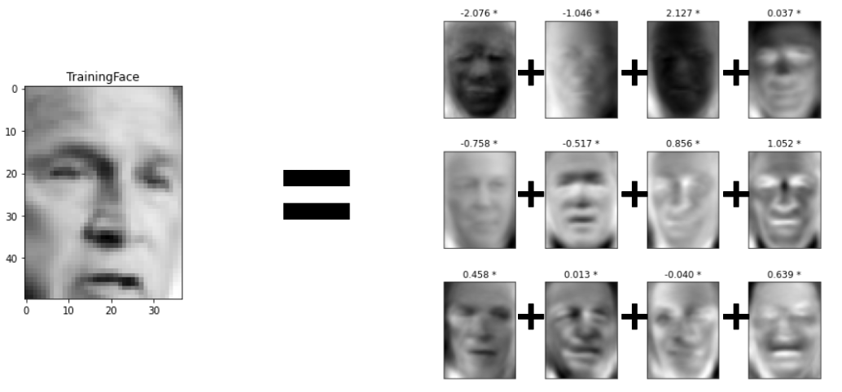
Eigenvectors of Face Dataset

Slide 7
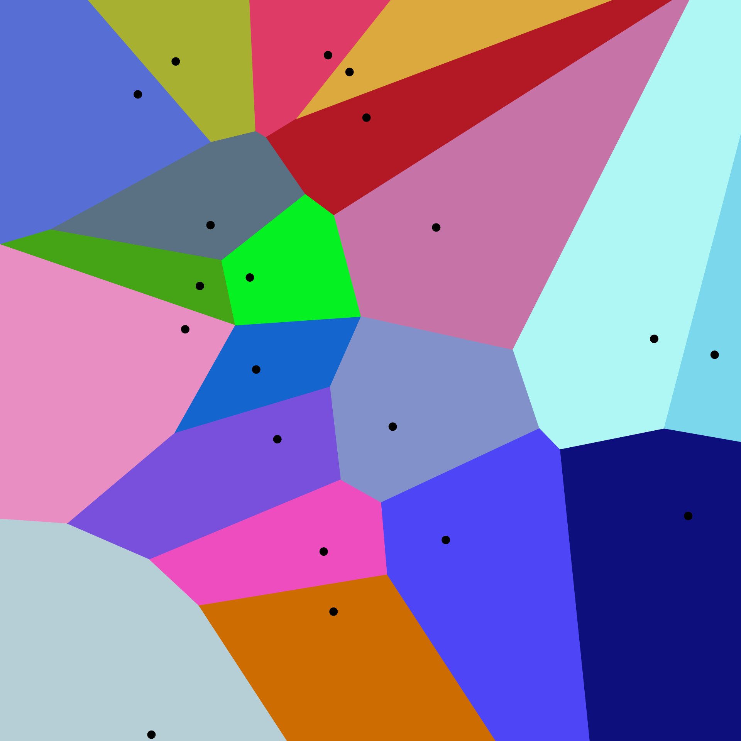
Voronoi Diagram
Given a set of points, assign regions of space to their closest points.

Slide 8
Visualizing K-Means
https://www.naftaliharris.com/blog/visualizing-k-means-clustering/

Slide 9
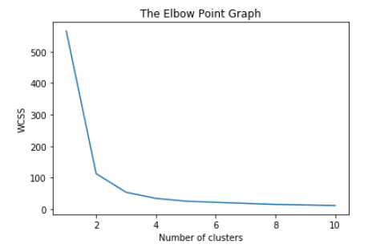
Finding Appropriate K

